Slide 1


Hybrid Identity mit Microsoft Azure
Peter Kirchner
Technical Evangelist
Microsoft Deutschland

Slide 2



Mobile & Cloud- challenging security paradigms
61% of workers mix personal and work tasks in their devices*
>80% of employees admit to using non-approved software-as-a-service (SaaS) applications in their jobs**
>70% percent of network intrusions exploited weak or stolen credentials ***
* Forrester Research: “BT Futures Report: Info workers will erase boundary between enterprise & consumer technologies,” Feb. 21, 2013
** http://www.computing.co.uk/ctg/news/2321750/more-than-80-per-cent-of-employees-use-non-approved-saas-apps-report
*** Verizon 2013 data breach investigation report

Slide 3
Why Microsoft’s Enterprise Mobility Solution?
Access from many devices
Manage and secure productivity
Preserve existing investments
Support iOS, Android, Windows
It’s integrated on common identity
It protects Office better
It just works
It’s comprehensive

Slide 4
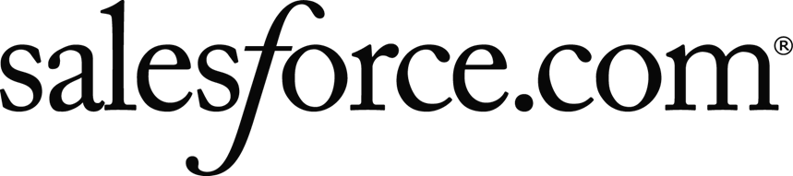


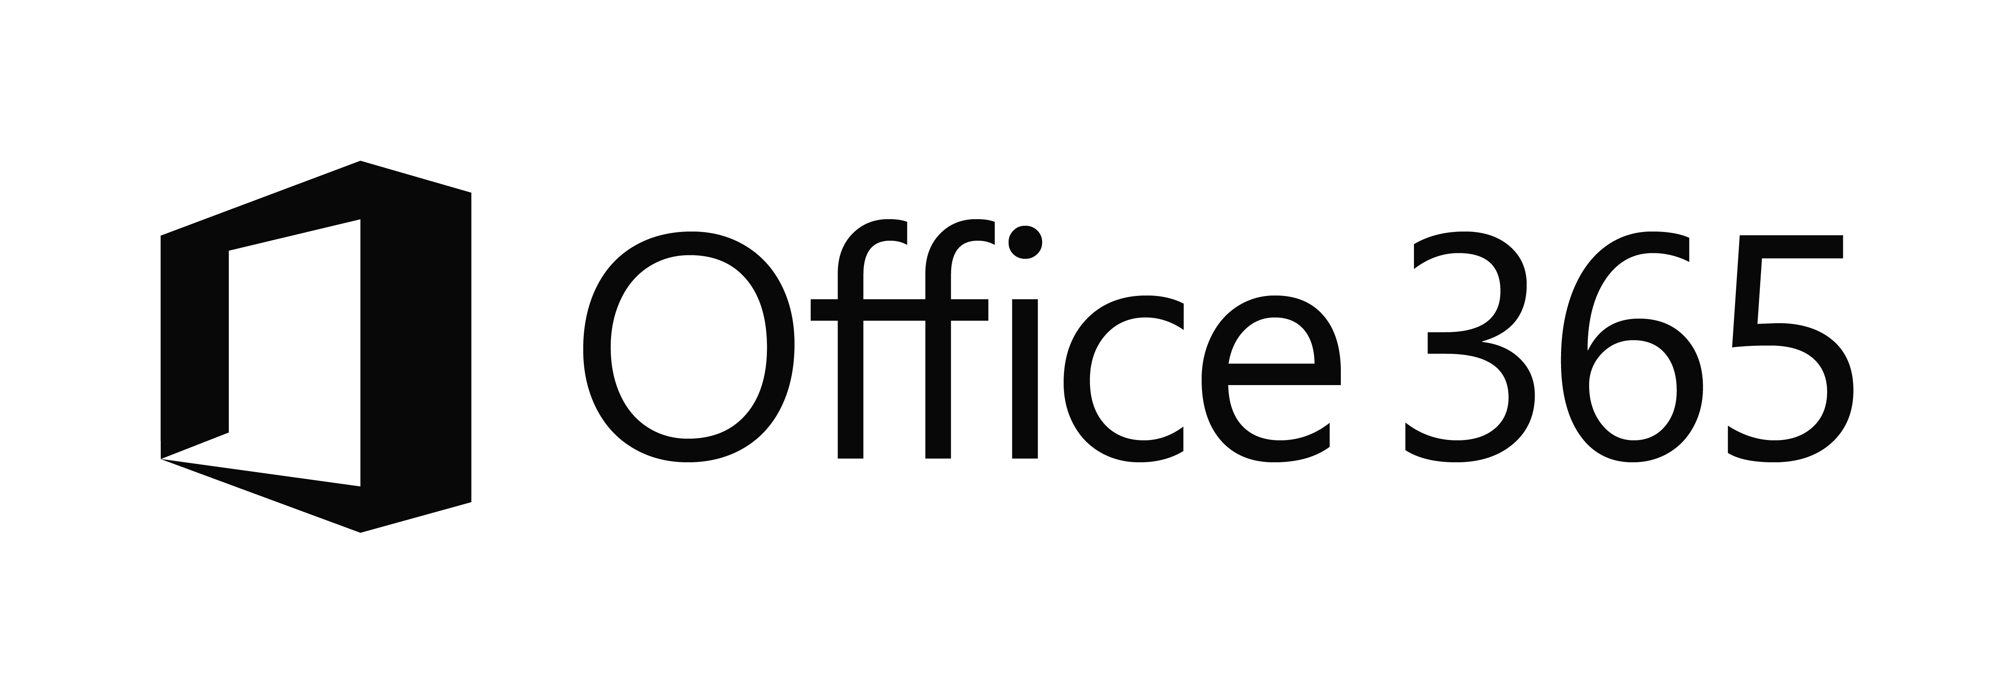

The current reality…
EC2
On-Premises
Managed devices
Private Cloud

Slide 5
Identity as the control plane
Simple connection
Self-service
Single sign on
Windows Server
Active Directory
Username
•••••••••••
Other Directories
SaaS
Azure
Public
cloud
Office 365
On-premises
Cloud
Microsoft Azure Active Directory

Slide 6
Azure Active Directory

Slide 7
What is Azure Active Directory?
A comprehensive identity and access management cloud solution.
It combines directory services, advanced identity governance, application access management and a rich standards-based platform for developers
It is available in 3 editions: free, Basic and Premium

Slide 8
Demo
Überblick Azure Active Directory

Slide 9
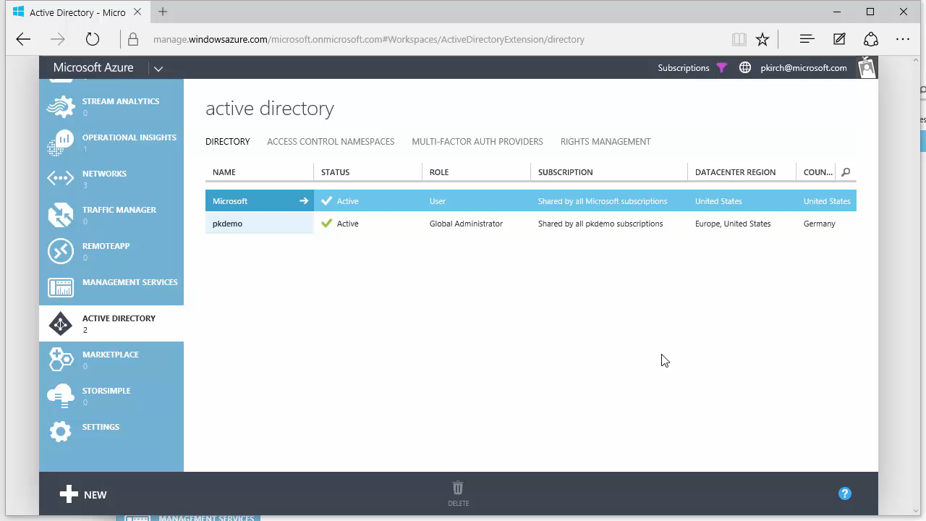

Slide 10
Your Directory on the cloud
Manage everything from passwords to devices.
Monitor and protect access to cloud applications.
Empower Users

Slide 11
Your Directory on the cloud
Manage everything from passwords to devices
Monitor and protect access to cloud applications.
Empower Users

Slide 12


Your Directory on the cloud
HR Apps
Connect and Sync on-premises directories with Azure.
Azure Active Directory Connect and Connect Health
MIM
*
*
PowerShell
Microsoft Azure
Active Directory
SQL (ODBC)
LDAP v3
Web Services ( SOAP, JAVA, REST)
Other Directories

Slide 13
Demo
Demo-Umgebung Active Directory

Slide 14
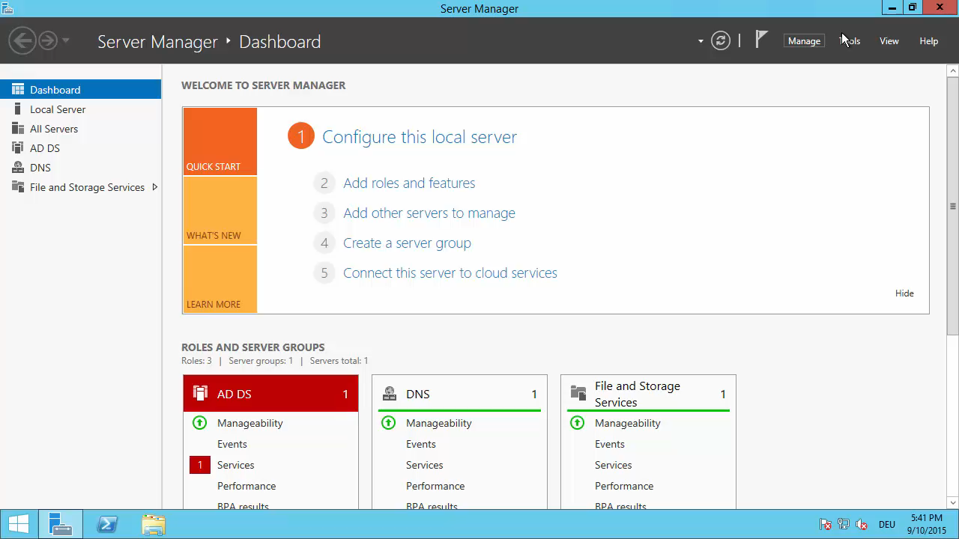

Slide 15

Making hybrid identity simple
Azure Active Directory Connect
Consolidated deployment assistant for your identity bridge components.
All currently available sync engines will be replaced by the Sync engine included in the Connect tool.
Assisted deployment of ADFS will be available through Azure Active Directory Connect.
ADFS is an optional component for authentication in Hybrid implementation. Password sync can replace ADFS for many scenarios.
DirSync
Azure Active Directory Connect
Azure Active Directory Sync
Sync Engine
FIM+Azure Active Directory Connector
ADFS
ADFS

Slide 16


Delivering a seamless user authentication experience
Active Directory
Microsoft Azure
Identity Synchronization with password (hash) sync
User attributes are synchronized using Identity Synchronization services including a password hash, Authentication is completed against Azure Active Directory
Identity Synchronization
Microsoft Azure
User attributes are synchronized using Identity Synchronization tools, Authentication is passed back through federation and completed against Windows Server Active Directory
AD FS

Slide 17
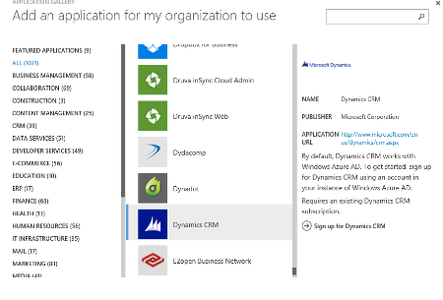
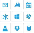
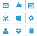
Your Directory on the cloud
Connect and Sync on-premises directories with Azure.
2400+ Preintegrated popular SaaS apps.
Microsoft Azure
Active Directory
SaaS apps
Other Directories

Slide 18
Demo
Azure Active Directory Connect einrichten

Slide 19
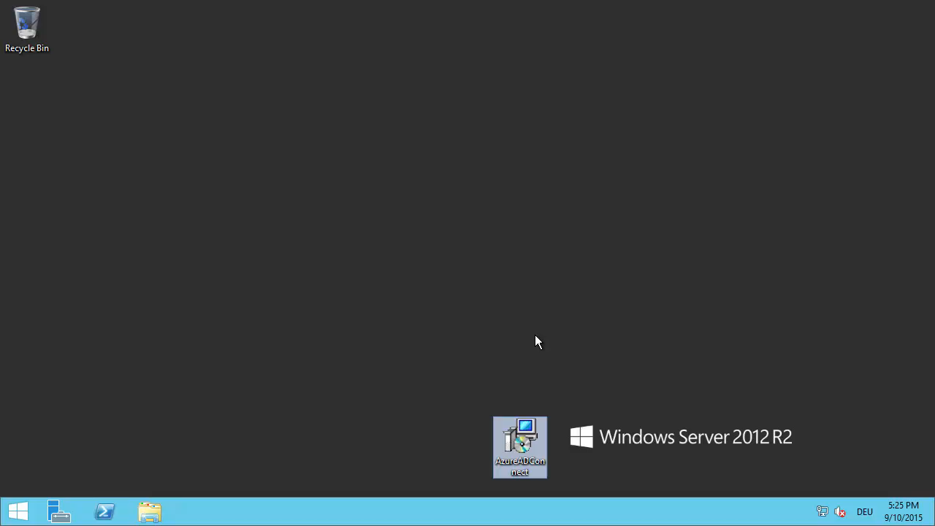

Slide 20
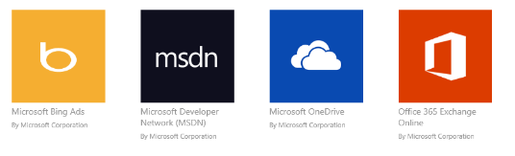
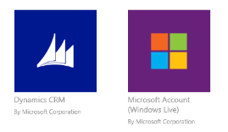
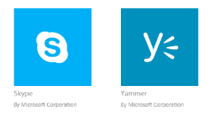
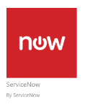
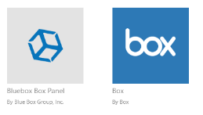
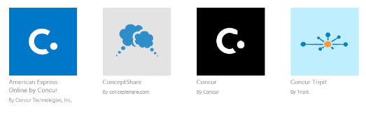
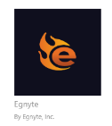


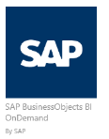
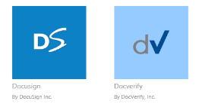
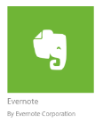


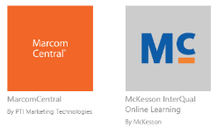
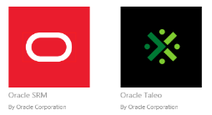
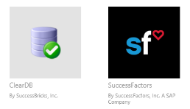
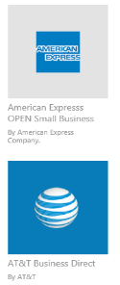
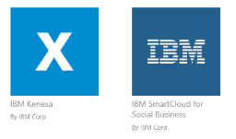

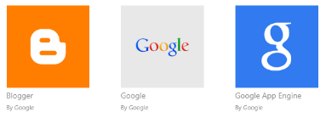
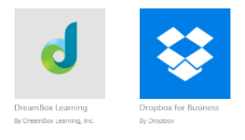
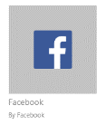



Preintegrated SaaS apps in the application gallery

Slide 21
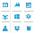
Your Directory on the cloud
Connect and Sync on-premises directories with Azure.
Other Directories
2400+ Preintegrated popular SaaS apps.
Microsoft Azure
Easily publish on-prem web apps via Application Proxy + Custom apps through a rich standards-based platform.
SaaS apps
Web Apps
(Azure Active Directory Application Proxy)
Integrated
custom apps
Identities and applications in one place.

Slide 22
Demo
Azure Active Directory Applications

Slide 23
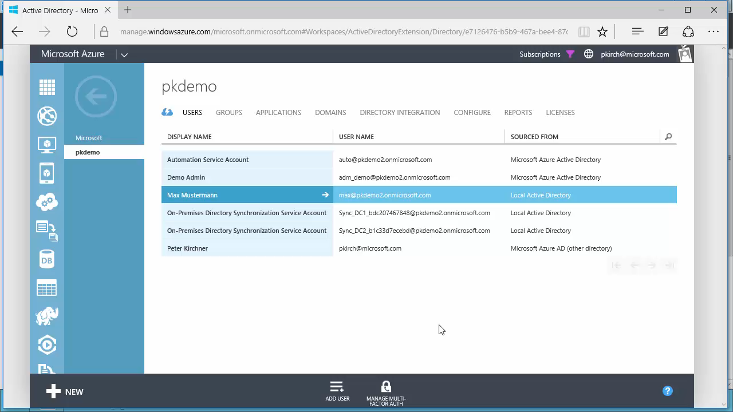

Slide 24
Azure Active Directory Application Proxy
Microsoft Azure
Active Directory
A connector that auto connects to the cloud service
https://app1-contoso.msappproxy.net/
Application Proxy
Multiple connectors can be deployed for redundancy, scale, multiple sites and different resources
Connectors are deployed usually on corpnet next to resources
Users connect to the cloud service that routs their traffic to the resources via the connectors
DMZ
Corporate Network
Connector
Connector
Resource
http://app1
Resource
Resource

Slide 25
Demo
Azure Active Directory Application Proxy

Slide 26
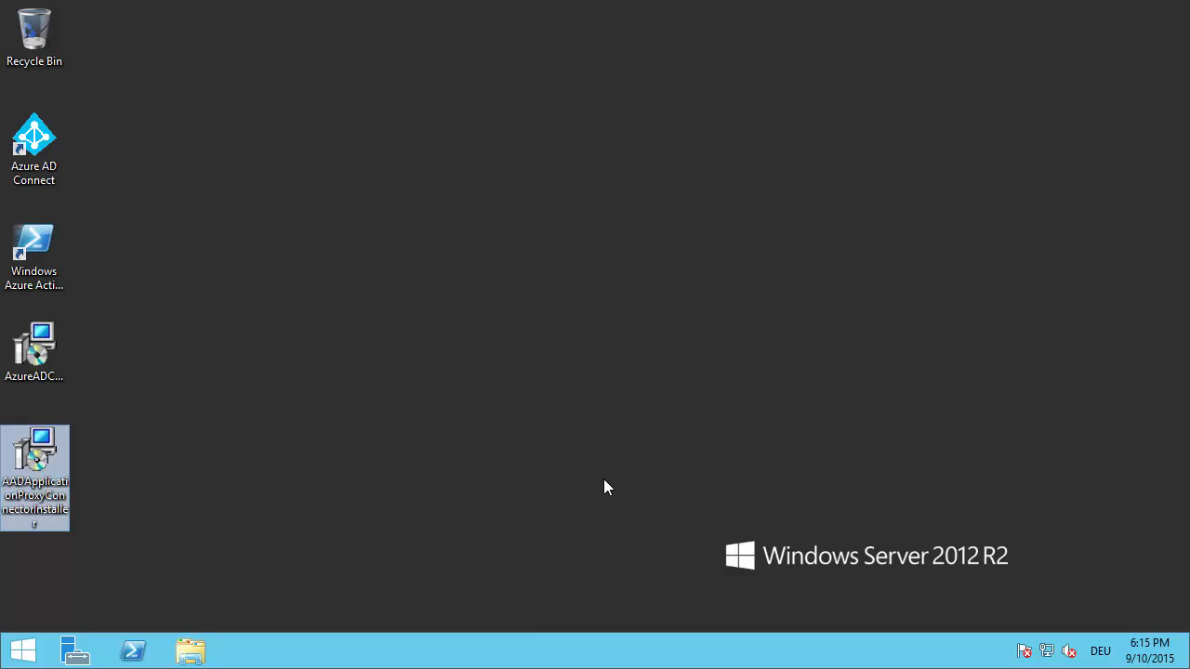

Slide 27


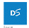


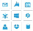
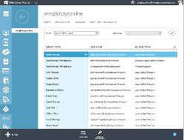
Manage everything from passwords to devices
Comprehensive identity and access management console.
Centralized access administration for preintegrated SaaS apps and other Cloud-based apps.
SaaS apps
Dynamic Groups, Device Registration Secure business processes with advanced access management capabilities.
IT professional
Your cloud apps ready when you are.

Slide 28
Azure AD Join for Windows 10
Azure AD Join makes it possible to connect work-owned Windows 10 devices to your company’s Azure Active Directory.
Users can sign into Windows with their cloud-hosted work credentials and enjoy modern Windows experiences.
Enterprise-compliant services
SSO from the desktop to cloud and on-premises applications with no VPN
MDM auto enrollment
Support for hybrid environments
Apps in Azure
Azure AD &
Intune
3rd party apps & clouds
MDM
Auto-enrolment
On-premises apps
Windows 10 Azure AD Joined Devices

Slide 29
Monitor and protect access to enterprise apps
Built-in security features.
XXXXX
Security reporting that tracks inconsistent access patterns, analytics and alerts.
Reporting API
XXXXX
XXXXX
Step up to Multi-Factor authentication.

Slide 30

What is Azure Multi-Factor Authentication?
A stand-alone Azure Identity and Access management service also included in Azure Active Directory Premium
Prevents unauthorized access to both on-premises and cloud applications by providing an additional level of authentication
Trusted by thousands of enterprises to authenticate employee, customer, and partner access.

Slide 31
Second Factor
Mobile apps
Phone calls
Text messages
1 4 5 6 7 6
ALERT

Slide 32
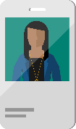
1
Users sign in from any device using their existing username/password.
2
Users must also authenticate using their phone or mobile device before access is granted.
User
On-Premises Apps
RADIUS
LDAP IIS
RDS/VDI
SAML
.NET, Java, PHP…
Cloud Apps
Multi-Factor
Authentication Server
Multi-Factor
Authentication Server
Microsoft Azure
Active Directory
Windows Server Active Directory or Other LDAP

Slide 33
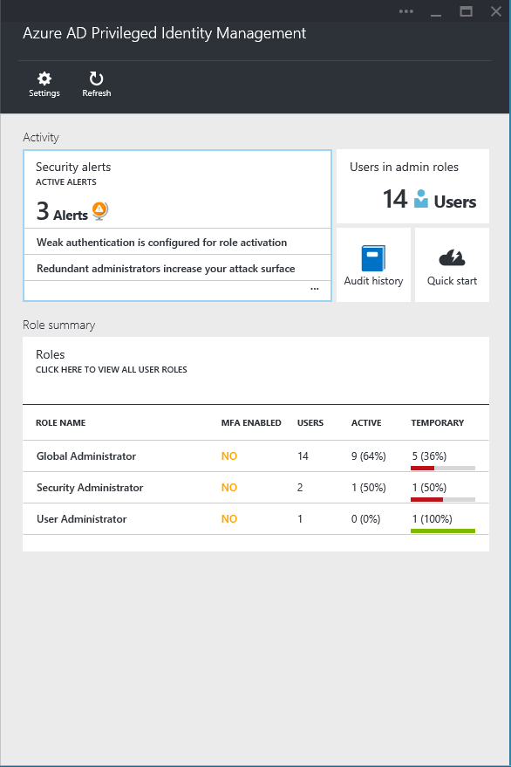
Privileged Identity Management
Discover, restrict and monitor privileged identities and their access to resources
Enforce on-demand, just in time administrative access when needed
Security reviews

Slide 34
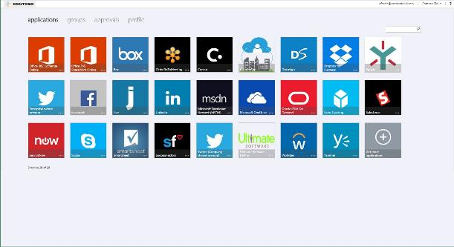
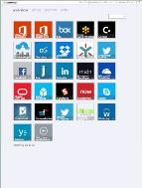
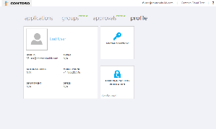
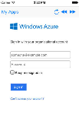
Empower Users
Company branded, personalized application Access Panel :
http://myapps.microsoft.com
+ Mobile Apps
Manage your account

Slide 35
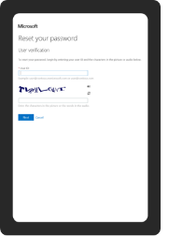
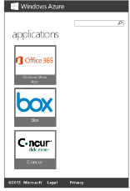
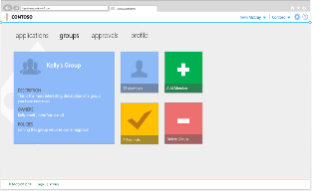
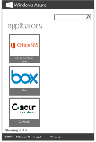
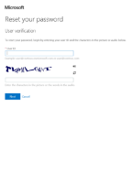
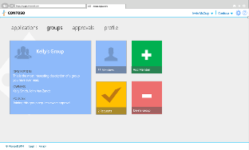

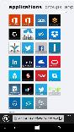
Empower Users
Company branded, personalized application Access Panel :
http://myapps.microsoft.com
+ Mobile Apps
Manage your account
Self Service Password Reset and application access requests

Slide 36
Weitere Informationen
 Peter.Kirchner @Microsoft.com
 blogs.msdn.com/
pkirchner
 Twitter: @peterkirchner
MVA: PowerShell: Azure-Automatisierung für Einsteiger
aka.ms/MVAAzurePowershell
Microsoft Azure 30 Day Trial
www.azure.com
Landing Page Microsoft Azure
azure.microsoft.com

Slide 37

© 2013 Microsoft Corporation. All rights reserved. Microsoft, Windows, and other product names are or may be registered trademarks and/or trademarks in the U.S. and/or other countries.
The information herein is for informational purposes only and represents the current view of Microsoft Corporation as of the date of this presentation. Because Microsoft must respond to changing market conditions, it should not be interpreted to be a commitment on the part of Microsoft, and Microsoft cannot guarantee the accuracy of any information provided after the date of this presentation. MICROSOFT MAKES NO WARRANTIES, EXPRESS, IMPLIED OR STATUTORY, AS TO THE INFORMATION IN THIS PRESENTATION.

